Slide 1
Module 5: Treatment support

Slide 2
Learning Objectives
Provide person-centred care for children and adolescents receiving treatment for TB disease or TB infection.
Decide on suitable formulations to provide correct dosages.
Follow up children and adolescents initiated on treatment for TB disease or TB infection (TPT).
Manage adherence issues and side effects, as well as provide support to the child or adolescent and their family throughout the whole treatment period.
Notes:
Once initiated on treatment for disease or infection, there is much to do on the treatment journey to ensure the optimal outcome. Each child or adolescent will have specific needs for treatment support that will depend on their age and development stage, their family and social context and whether or not they have any comorbidities. These needs are relevant irrespective of whether they are being treated for drug-susceptible TB, drug-resistant TB or for infection with TPT.
It is important to consider the most suitable formulations to provide the correct dosages.
Follow up is critical to manage adherence issues and any drug-related adverse events to provide age-appropriate support throughout the whole treatment period
Ensure that all children that start TB treatment or TPT are recorded in the TB treatment or TPT registers from the National TB Program.

Slide 3
Outline
Introduction
Person-centred care
Manage comorbidities
Monitor treatment response for TB
Treating infection with TPT
Summary
Case studies and role play
Notes:
This is the outline of what we will cover in this module.
We start with an introduction and talk about the important aspects of treatment support for children and adolescents treated for TB disease or infection.
This may include managing comorbidities. We will discuss follow-up to determine and manage treatment response as well as maintaining records of treatment and preparation of reports in due course.
We’ll conclude the module with a summary of key points for you to take away and at the end, there will be a case study, quiz and role play.

Slide 4
Outline
Introduction
Person-centred care
Manage comorbidities
Monitor treatment response for TB
Treating infection with TPT
Summary
Case studies and role play
Discussion
Discussion
Notes:
There will be a couple opportunities to share some of your own country specific practices and experiences.

Slide 5
Introduction

Slide 6
Discussion – setting specific practices
Note to facilitator:
Suggested instructions:
These context specific discussion opportunities will occur repeatedly throughout this training. Here are some suggestions on how you might like to facilitate them, to run them in a time efficient manner.
Explain that the next 15 minutes will be devoted to sharing amongst your colleagues, about how things may work in your setting.
Explain that 3, or 4, questions will be shown on the presentation.
Then divide the questions amongst the groups. Some groups may need to discuss the same question.
Tell them they will have just 2 or 3 minutes to discuss in their small groups. Then you will discuss as a large group.
Allow 2-3 minute discussion time.
When this time is up, ask for everyone’s attention. And then ask for volunteers to comment on each question discussed. Request participants to keep their responses succinct so that the time allows for others to also contribute.
Acknowledge all responses and thank participants for sharing.
Be mindful of the time and try to wrap up discussions so that the full activity takes no more than 15 minutes.
Click for audible instructions
To discuss Question 1
To discuss Question 4
To discuss Question 2
To discuss Question 3
Notes:
These context specific discussion opportunities will occur repeatedly throughout this training.
Here are some suggestions on how you might like to facilitate them, to run them in a time efficient manner.
Explain that the next 15 minutes will be devoted to sharing amongst your colleagues, about how things may work in your setting.
Explain that 3, or 4, questions will be shown on the presentation.
Then divide the questions amongst the groups. Some groups may need to discuss the same question.
Tell them they will have just 2 or 3 minutes to discuss in their small groups. Then you will discuss as a large group.
When this time is up, ask for everyone’s attention. And then ask for volunteers to comment on each question discussed. Request participants to keep their responses succinct so that the time allows for others to also contribute.
Acknowledge all responses and thank participants for sharing.
Be mindful of the time and try to wrap up discussions so that the full activity takes no more than 15 minutes.

Slide 7
Discussion: setting specific practices
What issues are important to consider for TB treatment initiation and what options are available including for young children?
1
What issues are important to consider for TPT initiation and what regimen options are available including for young children?
2
What are the main barriers to successful completion of treatment whether for TB treatment or TPT, and how do you address them?
3

Slide 8
What issues are important to consider for TB treatment initiation and what options are available including for young children?
1
What issues are important to consider for TPT initiation and what regimen options are available including for young children?
2
What are the main barriers to successful completion of treatment whether for TB treatment or TPT, and how do you address them?
3

Slide 9
General management considerations
ADULT & CHILD
ADAPT TO LOCAL SETTING
For treatment of TB disease and for TPT, choose:
The correct recommended regimen
The most suitable formulation
The correct dosage as determined by weight
The treatment supporter and provide education and counselling
Register all children and adolescents receiving:
TB treatment in the TB register
TPT in the TPT register
Record:
Treatment regimen and date of commencement in the child's health book
Weight at each visit in child's health book and TB treatment card and adjust dosages accordingly.
Notes:
Here are some general management considerations. Dosages for TB medications are determined by weight so an accurate weight is important for correct dosage as well as to monitor treatment response.
Consult national guidelines to ensure that you choose a recommended treatment or TPT regimen. Try to provide that treatment using the most suitable formulation that is easy to swallow and does not require breaking or crushing of tablets if possible. A treatment supporter should be chosen – for a child, usually a parent or a guardian who will ensure that the child takes the medication as instructed and can report back. For adolescents, they often take responsibility for self-administration but they may also want or need support so it is important to listen to and understand their needs and respect their preferences. Education and counselling of the child, adolescent and carers are always necessary, including or especially for TPT to convince that someone who is well needs to take treatment for some weeks or even months. Register treatment in the correct register and record treatment details as well as weight and other relevant management details in the child’s health book and clinic records, and ask the patient or guarding to bring these to each follow-up visit.

Slide 10
Other management considerations
Detect and manage comorbidities:
Nutritional rehabilitation
HIV care
Diabetes control
Adjuvant therapy:
Corticosteroids are recommended in the initial treatment of TB meningitis, pericardial TB and airway obstruction due to enlarged lymph nodes
Corticosteroids also may be indicated if TB IRIS* develops.
Pyridoxine for those receiving isoniazid especially with HIV infection or malnutrition.
Adverse event monitoring and management
*IRIS – Immune Reconstitution Inflammatory Syndrome
Notes:
Important comorbidities in children that are common and need management support include malnutrition, anaemia and/or HIV infection. Diabetes is a common comorbidity, especially in the Asia-Pacific region that may also occur in adolescents. People with TB can also have ongoing respiratory disease, especially adolescents living with HIV.
Additional therapies are sometimes required, such as corticosteroids which are routinely used in the initial treatment phase of TB meningitis and pericarditis.
At treatment initiation, explain which are the main side-effects to be aware of, explain how to manage and monitor for side-effects at follow-up.
Pyridoxine reduces neurological side-effects from isoniazid, so it is especially important in those living with HIV/AIDS or severe malnutrition.

Slide 11
Person-centred care

Slide 12
Person-centred care for TB disease
Consult and check with national guidelines.
Choose the appropriate regimen.
Determine correct dosage by weight.
Select suitable formulation.
Provide education and counselling.
Engage child/adolescent themselves as well as caregiver.
Provide home- or community-based treatment support.
I have a rash!
Let’s fix that!
Support nutrition.
Provide HIV-related care.
Monitor and manage any side-effects.
Notes:
Always check national guidelines on the treatment of drug-susceptible or drug-resistant TB to choose the appropriate treatment regimen. In addition, you need to determine the correct dosage and select the most age-appropriate treatment formulations to be used. Successful management of TB treatment also includes managing any drug side-effects. It is important to provide age-appropriate education and counselling to the child or adolescent along with their families and caregivers who will be involved in supporting adherence and decisions regarding treatment. HIV testing and care and nutritional assessment are standards of care. Nutritional support may be required, especially during the first two months of treatment until there is satisfactory weight gain.

Slide 13
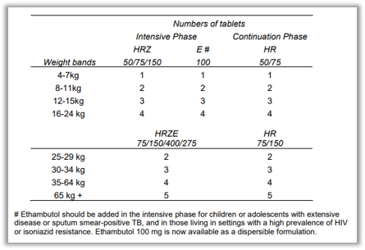
Determine dosage for treatment by weight
Notes:
As explained earlier, the correct drug dosages are determined by weight and the weight determines the weight band where a child belongs. We use standard formulations, and for example, one pediatric fixed dose combination tablet of isoniazid-rifampicin-pyrazinamide (HRZ) contains 50 mg of isoniazid, 75 mg of rifampicin and 150 mg of pyrazinamide. We also know the recommended doses for each medicine (not shown on this slide) and therefore, it follows, that a child who weighs, for example, 10 kg (and belongs to the weight band of 8-<[less than]12 kg) would need 2 of those tablets and also 2 ethambutol tablets of 100 mg.

Slide 14
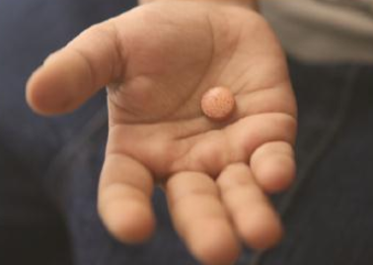
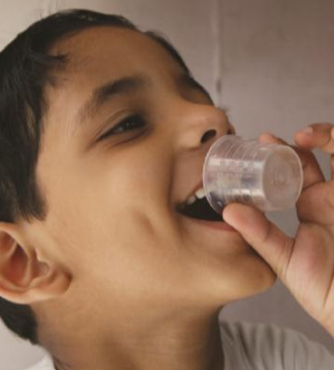
Choose appropriate formulations
Check which treatment formulations are available in your setting as single drug or FDC:
Weight-based dosing charts support correct dosing
DS-TB
HRZ
50/75/150
HR
50/75
Ethambutol
100mg
Child friendly FDC dispersible and fruit flavoured
Now available as single dispersible formulation
DR-TB
Increasing numbers of appropriately dosed and dispersible second-line drugs.
TPT
Dispersible formulations include HR 50/75, rifapentine and levofloxacin.
Caregivers should be educated on how to administer the child friendly formulations.
Notes:
Whether treating TB disease or TB infection, you should check which treatment formulations are available in your setting as single drugs or as fixed-dose combinations.
RHZ 75/50/150 and RH 75/50 are child friendly formulations of a fixed dose combination which are dispersible and fruit flavoured.
Ethambutol 100 mg is now available as a single dispersible formulation.
Caregivers should be educated on how to administer the child friendly formulations.
The treatment of infants <4 kgs – usually neonates (< 2 months) – require specific dosing by weight.
Infants and young children may change weight rapidly over time of TB treatment. It follows that you need to weigh them at every visit and adjust the dosage when necessary.
Fixed-dose combinations reduce the pill burden and any risk of dosing errors. Child-friendly, dispersible formulations are widely available for accurate dosing in children weighing less than 25 kilograms for the treatment of disease or infection of drug-susceptible conditions. Fixed-dose combinations of rifampicin 75 mg; isoniazid 50 mg; pyrazinamide 150 mg and of rifampicin 75 mg; isoniazid 50 mg are available; they are dispersible in ten milliliters of water without needing to be crushed and are fruit flavoured. It is important to show caregivers how to administer the child friendly formulations and to check that they feel confident in doing this – as illustrated on the slide .
Single drug formulations are still commonly required in the treatment of drug-susceptible or drug-resistant TB disease as well as to treat TB infection such as with isoniazid preventive treatment for children with HIV. More and more child-friendly formulations are in use, including ethambutol 100 mg and the second-line drugs to treat drug-resistant TB.
The treatment of TB in adolescents uses similar principles and formulations to treatment in adults, including available fixed-dose combination tablets for drug-susceptible TB. As you learnt, four drugs are commonly recommended to treat drug-susceptible TB in adolescents to reduce the risk of developing drug-resistant TB or relapse.

Slide 15
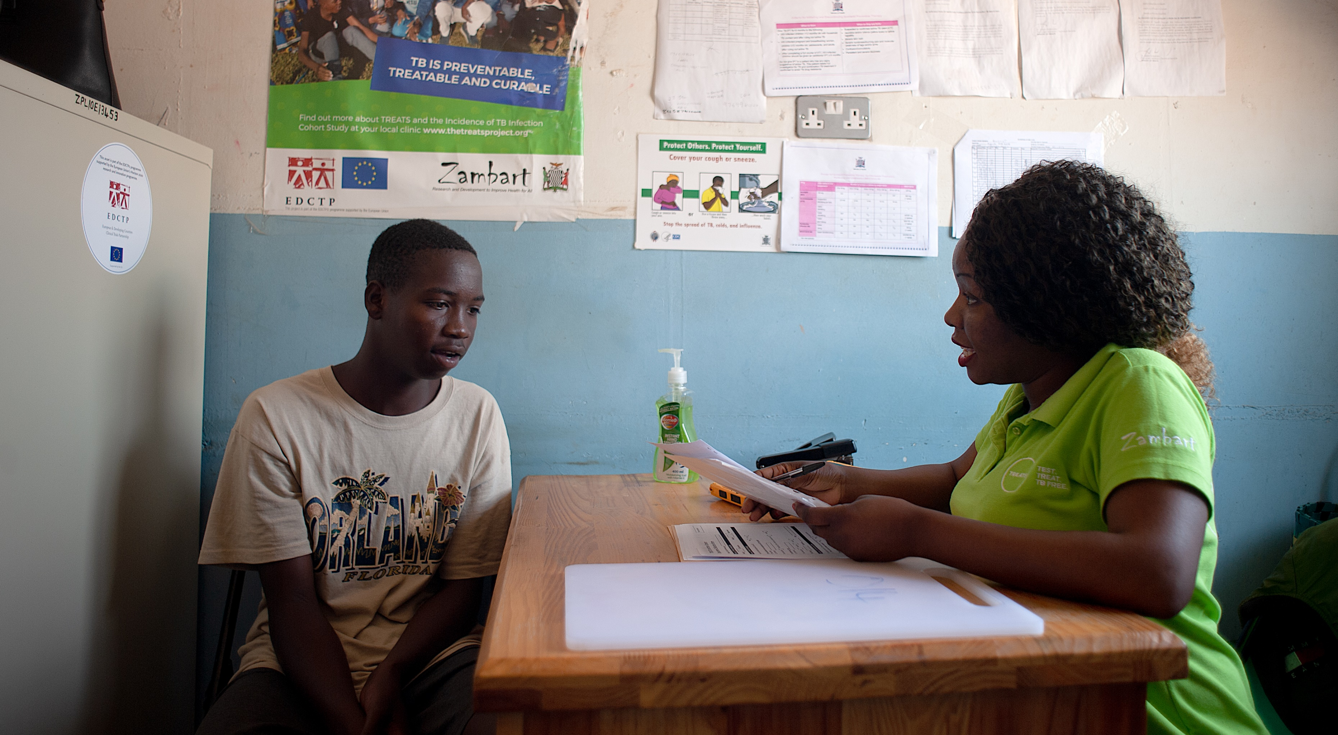
Education
Notes:
Treatment support starts with the decision to initiate treatment. The best way to provide this support should be discussed with the caregiver or adolescent themselves, depending on the age and the family circumstances. Engaging caregivers and families in the care of children and adolescents initiated on TB treatment is critical to ensure treatment adherence and completion

Slide 16
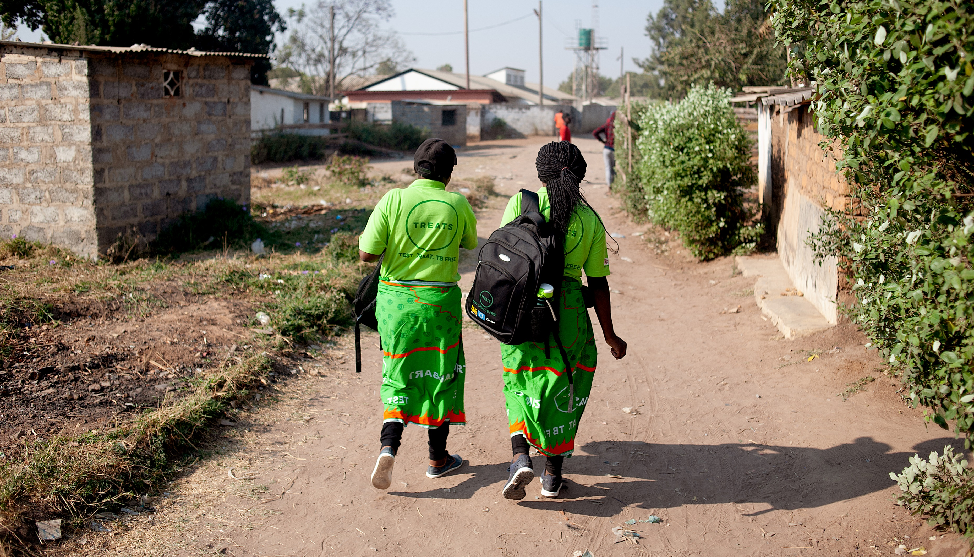
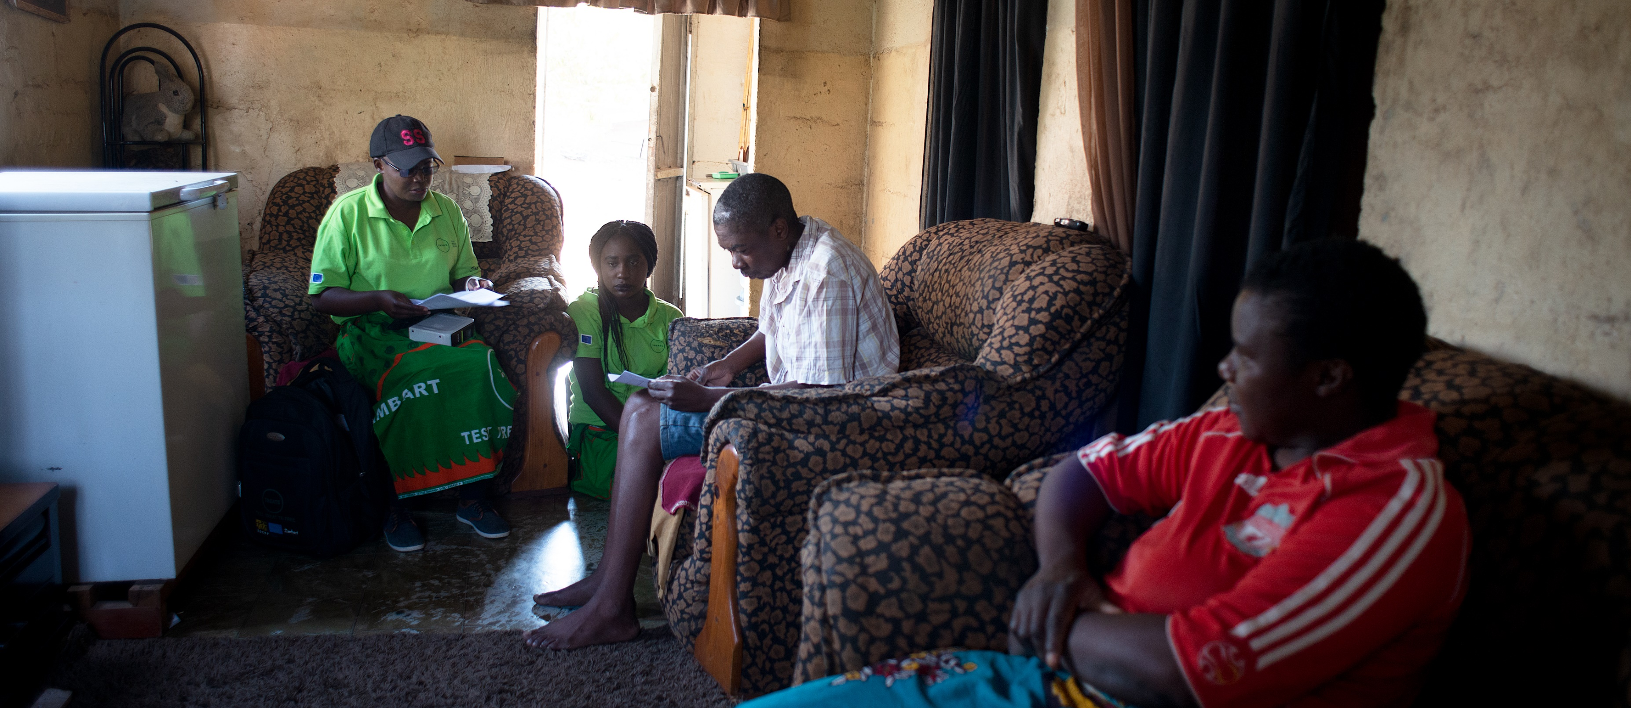
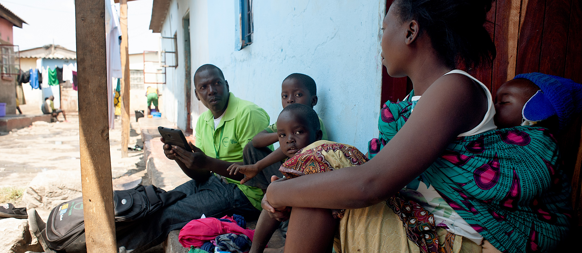
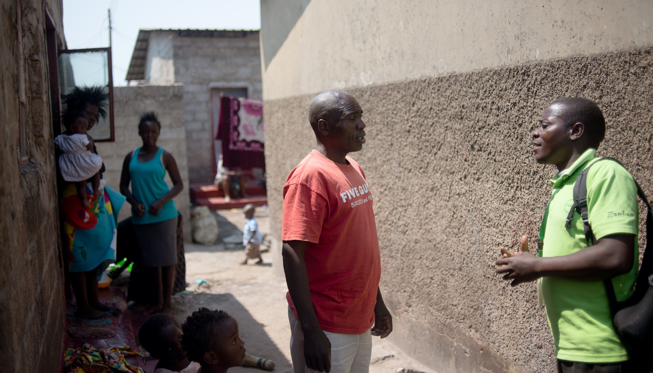
Education and counselling for treatment support
Treatment support
Notes:
A family-centred, integrated decentralised approach with home-based treatment support that does not require frequent visits to health facilities is preferred to reduce loss to follow-up and costs. Guidance is often required about infection control practices in the home as well as when the child or adolescent can return to school.

Slide 17
Treatment adherence
Adherence is pivotal to successful treatment:
Family centered care is a key strategy.
Patient treatment cards should be used.
Engage and educate treatment supporters or providers.
Adolescents have age-specific challenges for care:
Attention to the individual’s needs and preferences is essential.
Need to involve adolescents directly as active participants in their treatment plan.
Support to continue education or employment.
Address real or perceived concerns about stigma.
TB treatment card
See also Section 6 of the WHO operational handbook on tuberculosis. Module 5: management of tuberculosis in children and adolescents. World Health Organization, Geneva, 2022
Notes:
The main reason for an unsatisfactory treatment outcome in children and adolescents is loss to follow-up. As adherence is pivotal to successful TB treatment, it is important that healthcare providers bring back to treatment those who have interrupted their treatment. Engaging the family or carers in treatment support is another key strategy. Patient treatment cards should be used for documenting treatment adherence.
Adolescents have age-specific challenges for care, including adherence support, reducing any associated stigma and supporting their mental health. Treating adolescents requires respectful attention to the individual’s needs and preferences with recognition of their autonomy. This also includes support to continue education. Involving adolescents directly in their care helps to engage them as active participants in their treatment plan and is strongly advised. Examples are provided in the WHO operational handbook, such as providing access to TB services outside school hours and the provision of adolescent-friendly information on TB.

Slide 18
Manage comorbidities and other conditions

Slide 19
Managing comorbidities and special populations
WHO Operational Handbook: Section 7 covers the management of children and adolescents with important comorbidities:
Management of other special populations includes also:
TB in pregnancy and management of newborns of mothers with TB
Palliative care for children and adolescents with TB
Care for adolescents with or at risk of TB
TB in children with pneumonia
Living with HIV
Severe malnutrition
Notes:
For person-centred care to be effective and supportive, we need to provide appropriate care for any comorbidities such as HIV infection, malnutrition, anaemia or severe pneumonia as and when required. For example, children and adolescents living with HIV treated for disease or TPT require HIV-related care, and indeed may require adjustment to dosages of ART while receiving TB treatment. Another common TB comorbidity is malnutrition which requires nutritional support and rehabilitation as an inpatient or in the community. Care for comorbidities should be integrated with TB treatment as much as possible, including at the primary care level.
We may also need to provide TB care for other vulnerable and high-risk populations such as pregnant women and their newborns, usually within the context of perinatal services.
Section 7 in the WHO operational handbook module 5 provides detailed guidance on these issues.

Slide 20
Management of TB in the context of HIV
Management of care for children and adolescents living with HIV who also have TB should be integrated.
The principles of TB treatment and contact management are the same as for HIV uninfected children and adolescents.
CPT* and ART improve TB outcomes and should be initiated regardless of CD4 counts.
ART should be continued or initiated as soon as possible (within two weeks) after starting TB treatment.
Possible drug–drug interactions should be considered especially for regimens containing rifamycins.
*CPT – co-trimoxazole preventive treatment
Notes:
The treatment of TB disease or infection in children and adolescents living with HIV follows a similar approach as for HIV-negative children and adolescents requiring TB treatment or TPT. Children and adolescents with TB-HIV should be initiated on ART and cotrimoxazole preventive therapy regardless of CD4 counts as they have a role in reducing TB-related deaths which are especially common within the first months following TB treatment. Considerations should be made for possibility of drug–drug interactions as rifampicin lowers the plasma levels of Nevirapine, Protease Inhibitors, Integrase inhibitors making ART substitutions or dose adjustments necessary according to national guidelines. The WHO operational handbook and national guidelines for TB and HIV care provide specific guidance for adjustments if required.

Slide 21
Management of infant of mother with TB
Pregnancy-related TB often presents in perinatal period – last trimester or within three months post-natal.
TB during pregnancy can be difficult to diagnose and is associated with preterm delivery, low birth weight or still birth.
Congenital TB is rare, and presentation is non-specific – similar to other congenital infections or newborn sepsis.
Approach to infant of mother with TB – follow guidelines!
Consider active TB in the infant.
If diagnosed, treat for same TB (DS or DR) as mother.
If no active TB, TPT (for DS or DR) is indicated and delay BCG.
Careful dosing by weight for treatment of TB or TPT.
Safe to breast feed – negligible risk of transmission of TB or drugs to infant.
Notes:
Pregnancy is associated with an increased risk of Tb in the mother, usually presenting with symptoms in last trimester or early post-partum period. It can be difficult to diagnose especially antenatally and is associated with negative outcomes for the baby.
Congenital TB is rare but does occur especially if the mother has disseminated or genitourinary TB. The presentation is non-specific and TB in the mother should alert to the possibility/
There are clear guidelines such as in WHO operational handbook on how to manage an infant of a mother with perinatally diagnosed TB. As for any contact, first consider active TB and if no evidence, consider TPT – as well as optimal timing of BCG if not infected. If the infant is born to a mother with HIV, follow HIV guidelines for care as well.
Breast feeding can be initiated and continued as usual when a mother has TB as the risk of transmission is negligible and the transfer of anti-TB drugs in breast milk is small.

Slide 22
Discussion: setting specific practices
Do you have guides or job aides readily available to facilitate correct choice of treatment regimen and dosages?
1
Do you have dispersible "child-friendly" formulations available and how do you determine which formulation and dosage to use?
2
What are the common comorbidities in children and adolescents with TB in your setting and how do you manage them?
3

Slide 23
Do you have guides or job aides readily available to facilitate correct choice of treatment regimen and dosages?
1
Do you have dispersible "child-friendly" formulations available and how do you determine which formulation and dosage to use?
2
What are the common comorbidities in children and adolescents with TB in your setting and how do you manage them?
3

Slide 24
Monitor treatment response for TB

Slide 25
TB treatment response
A poor treatment response may indicate:
Poor adherence
Drug-resistant organism
Incorrect dosages
Comorbidities not managed e.g., HIV infection
Incorrect diagnosis
Children and adolescents with TB usually respond well with satisfactory treatment outcomes.
TB drugs in children are usually very well tolerated.
More drug-related adverse events associated with second-line drugs.
Notes:
Most children and adolescents with TB respond well to treatment with symptomatic improvement during intensive phase and with a good outcome if the majority is treatment is taken. TB drugs are usually well tolerated so that severe toxicity is rare – and since injectables which commonly caused hearing loss are no longer used to treat drug-resistant TB, most children and adolescents also tolerate the treatment of drug-resistant TB. The main challenge is linezolid that can cause bone marrow suppression and neurological symptoms.
A poor response to TB treatment may indicate poor adherence. If adherence is satisfactory and dosages are correct, then consider drug-resistant TB, or co-morbidities not being effectively managed or even an alternative diagnosis,

Slide 26
Monitoring TB treatment response
Monitoring | Components
Clinical | Check for symptom resolution and weight gain. Measure weight and adjust the dosage accordingly. Establish treatment support and monitor adherence. Elicit and manage adverse events as per guidelines. Advise immediate cessation of treatment and review if evidence or concerns of hepatotoxicity such as nausea, vomiting and jaundice. Refer children and adolescents with treatment failure or severe adverse event for further management.
Laboratory | Check sputum conversion for adolescents with bacteriologically confirmed TB as per national recommendations in adults.
Imaging | Follow-up CXR is not routinely required; indicated if poor treatment response and diagnostic uncertainty.
Notes:
Most will be monitored clinically. Check for symptom resolution and measure the weight at each clinic visit, adjusting doses as required. Establish treatment support, monitor adherence and elicit and manage adverse events as per guidelines. The main serious adverse events of concern are listed on the next slide.
Children and adolescents with treatment failure or severe adverse events may require referral for further management.
Note that CXR is not routinely required in follow-up to monitor treatment response if the child is responding well clinically to TB treatment. Abnormal CXR findings often persist beyond treatment completion, even when there is cure or clinical response. Repeat sampling for resistance testing and imaging are indicated if treatment response is unsatisfactory with concerns of drug resistance or incorrect diagnosis.

Slide 27
Adverse events
Drugs used to treat TB disease or infection are usually well tolerated.
Ensure that dosages are correct for weight
Serious adverse events are rare, but the main ones of concern requiring immediate cessation of treatment are:
Hepatotoxicity
Hypersensitivity (including Stevens-Johnson syndrome)
Optic neuritis
Peripheral neuropathy
Neuro-psychosis
Ototoxicity with permanent hearing loss
Notes:
Children and adolescents will generally tolerate the drugs used to treat or prevent TB very well. Serious adverse events are rare but it is always important to ensure correct dosage by weight.
Hepatotoxicity or liver failure is extremely rare but requires immediate cessation of drugs with liver function test – it will present with nausea, vomiting and jaundice. It can be caused by any of the main three first-line drugs: isoniazid most commonly but also rifampicin or pyrazinamide. Therefore, it can also occur with TPT containing isoniazid or rifampicin.
Rifampicin or rifapentine can cause hypersensitivity reactions with skin rash and joint pain – or rarely a severe mucocutaneous reaction known as Stevens Johnson syndrome. If severe, drug should be stopped immediately and not reintroduced.
Ethambutol and linezolid can both cause optic neuritis which presents with blurred or loss of vision. However, young children may not be able to report these symptoms. These are related to dosage and duration of treatment. Ethambutol is safe for all ages as long as recommended dosages are used.
Isoniazid and linezolid can cause peripheral neuropathy which presents with tingling or numbness in the toes and feet.
Cycloserine and isoniazid can cause neuropsychosis especially in severely malnourished adolescents.
Pyridoxine is given routinely and especially to children or adolescents with severe malnutrition or living with HIV to reduce the risk of peripheral or central neuropathy.
Ototoxicity often leading to profound and permanent hearing loss was common with the injectable second-line drugs used to treat MDR/RR-TB. Fortunately, almost all children and adolescents with MDR/RR-TB no longer require these drugs and can be treated with all-oral regimens.

Slide 28
Post-TB care
Ongoing assessment care may be required for children and adolescents who have successfully completed treatment for TB, such as:
Neurological sequelae with disability ranging from mild to severe:
Common following TB meningitis - such as paralysis, cognitive or learning problems, seizure disorder, visual disturbances, feeding difficulties and behavioural difficulties
Scoliosis and paralysis of lower limbs or bladder following spinal TB
Peripheral neuropathy, visual or hearing loss following treatment for MDR/RR-TB
Chronic lung disease with restrictive lung function or bronchiectasis, especially common in CALHIV
Social and educational support
Support for mental health
Notes:
Children and adolescents can suffer long-term sequelae including disability as a result of TB disease or its treatment – and this may require ongoing management with appropriate health service provider.
TB meningitis commonly causes permanent neurological disability which can be mild to severe and manifests in a range of dysfunction including motor, cognitive or behavioural while TB of the spine can cause long-term paraplegia.
The drugs used to treat TB, especially drug-resistant TB, can cause permanent neuropathies such as peripheral neuropathy, optic neuropathy with visual loss or hearing loss which if severe, has a profound impact on a child’s language development. Fortunately, injectable aminoglycosides are rarely required to treat drug-resistant TB anymore.
It is well recognised that older children and adolescents living with HIV commonly develop chronic lung disease which can be very debilitating and exacerbated by TB. It is only recently recognised that TB in HIV-uninfected infants and children can also cause long-term lung dysfunction even if less profound and debilitating than that for adolescents with perinatally acquired HIV infection. Post-TB lung disease is now a focus for all ages but while common, we still have limited knowledge about potentially effective interventions for care.
Finally, TB is commonly associated with mental health challenges such as depression as well as social and educational disruption, and care and support may be required beyond TB treatment completion.

Slide 29
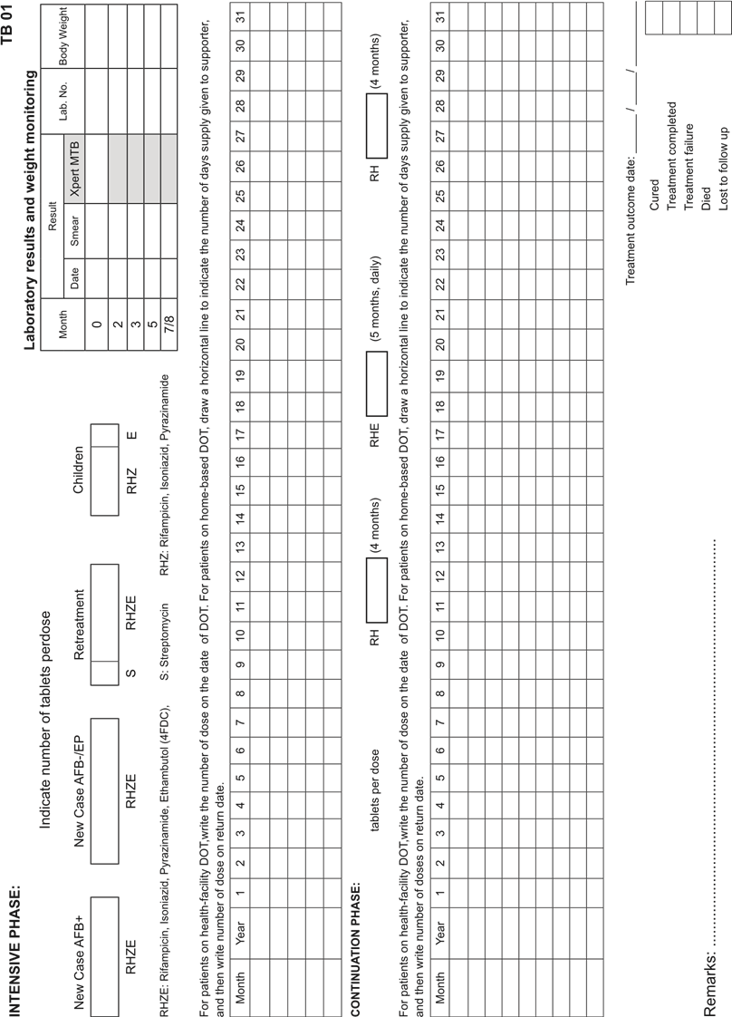
Recording and reporting for TB treatment
NTP registration of all cases for treatment critical for:
Monitoring and evaluating epidemiology
Identifying policy-practice gaps
Procurement of diagnostics and drugs
Data on treatment outcomes.
Reporting should be disaggregated by age.
Treatment outcomes should be routinely recorded and reported for all children and adolescents diagnosed with TB, including RR/MDR-TB.
Notes:
NTP registration of all cases for treatment is mandatory and treatment outcomes should be routinely reported and recorded by age groups. Treatment outcome is a vital programmatic indicator but also reflects quality of care. Age-disaggregated case notification data are important for TB surveillance, evaluating epidemiology, identifying policy-practice gaps and to inform procurement needs of diagnostics and treatment formulations. Data on standardised treatment outcomes also help identify at-risk groups for unsatisfactory outcomes. Module 7 will cover reporting of treatment outcomes.

Slide 30
TB treatment outcome definitions
Outcome | Definition
Cured | A pulmonary TB patient with bacteriologically confirmed TB at the beginning of treatment who completed treatment as recommended by the national policy with evidence of bacteriological response and no evidence of failure
Treatment completed | A person with TB disease who completed treatment as recommended by the national policy whose outcome does not meet the definition for cure or treatment failure
Treatment successful | A person with TB disease who was either cured or who completed treatment as defined above
Treatment failed | A person with TB disease whose treatment regimen needed to be terminated or permanently changed to a new regimen or treatment strategy.
Died | Death from any reason before starting or during the course of treatment.
Lost to follow-up | Either did not start treatment or treatment was interrupted for two consecutive months or more.
Not evaluated | A person with TB to whom no treatment outcome was assigned, excluding those lost to follow-up.
Notes:
Listed here are the current WHO definitions for outcomes for treatment of TB.
They are similar for all TB patients irrespective of age and same for drug susceptible or drug-resistant TB. Most treatment success in children is recorded as treatment completed as cure cannot usually be established.
The main negative outcome in children or adolescents is LTFU which is why the emphasis on treatment support is important. Most will feel much better, gain weight and have symptom resolution within two months of starting treatment but it is important to emphasise that completion of the full course is required to reduce risk of relapse or resistance development.

Slide 31
Treating infection with TPT

Slide 32
Determine dosage for TPT regimen of choice
Weight band | 3HR 50/75 mg dispersible FDC | 6H 100 mg tablet | 3HP H 100 mg, P 150 mg tablets
4-7.9 kg | 1 | 0.5 | - | -
8-11.9 kg | 2 | 1 | - | -
12-15.9 kg | 3 | 1.5 | 3 | 2
16-24.9 kg | 4 | 2 | 5 | 3
Notes:
As for treatment of TB disease, the dosages for TPT are also determined by weight. Once you have chosen the suitable TPT regimen for the child, then the child's weight determines the weight band where a child belongs. 3HR is very suitable for children of less than 25 kgs (usually less than 10 years) because it for just 3 months, can be used for all ages and there is a suitable dispersible, fixed-dose formulation of 75mg rifampicin with 50 mg isoniazid widely available. Three months of weekly rifapentine and isoniazid or 3HP is likely to become an option for all ages including less than 2 years or less than 12 kgs in 2024. A suitable formulation of 150 mg of dispersible rifapentine is being developed but dosage guidelines and recommendations are not yet available to guide.

Slide 33
Monitoring treatment with TPT
Monitoring | Components
Clinical | Measure weight. Check for development of any symptoms including weight loss. Evaluate for disease if TB-related symptoms or signs develop. Adjust the dosage of TPT if required. Check adherence to TPT with caregiver, child or adolescent. Elicit and manage any adverse events as per guidelines. Advise immediate cessation of treatment and review if evidence or concerns of hepatotoxicity such as nausea, vomiting and jaundice.
Laboratory | Not routinely required if well. As required to investigate TB disease or adverse events such as check liver function tests.
Imaging | Only indicated if requires evaluation for TB disease.
Notes:
Children or adolescents receiving TPT should be monitored clinically. Check for development of any symptoms and measure the weight at each clinic visit, adjusting dosages as required. Check adherence and elicit and manage adverse events as per guidelines.
Overall, children and adolescents tolerate TPT extremely well. Hepatotoxicity is extremely rare but requires immediate cessation of drugs with liver function test – it will present with nausea, vomiting and jaundice.
Other investigations such as Xpert testing or CXR are only required if TB-related symptoms or signs develop.

Slide 34
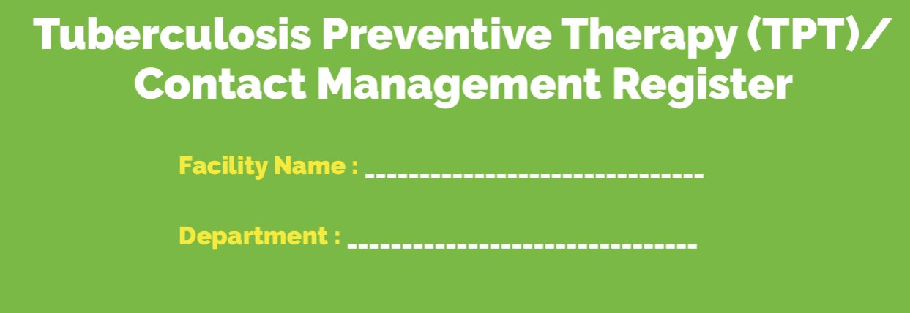
Data for contact screening and TPT
ADULT & CHILD
ADAPT TO LOCAL SETTING
Use contact screening and TPT register to record and report data on important indicators for contact investigation:
Age of contact
Date screened for TB
TB case detected
TB case treated
Cascade of TPT
Eligibility for TPT
TPT initiated
TPT completed
Treatment outcomes should be reported as proportion completed.
Notes:
Use the contact management and TPT register in your country which will record important data such as age, results of TB screening and TPT eligibility. Important NTP indicators include numbers of contacts eligible for TPT, numbers and proportions initiated and numbers and proportions completed. These are often reported as a cascade of care. Treatment outcomes for TPT are defined by WHO and presented in Module 7.

Slide 35
Conclusion Summary of key points

Slide 36
Summary of key learning points
Person-centred care includes choosing correct regimen with the most suitable formulations while ensuring treatment adherence and providing integrated management for comorbidities or complications, including nutritional support.
Establish rapport with the child or adolescent and their parents/caregiver, check weight at each follow-up visit, adjust the drug dosages if required and reinforce education for completion of treatment for disease or TPT.
In children and adolescent living with HIV, follow guidelines including the choice of regimen to treat TB disease or infection, and in initiation or adjustment of ART.
If unsatisfactory TB treatment response in spite of satisfactory adherence, consider drug-resistant TB or an alternative diagnosis.
Notes:
Listed here are some the key points for treatment support for both TB disease or infection.
Person-centred care includes choosing the recommended regimen and using the most suitable formulations while ensuring treatment adherence and providing integrated management for comorbidities or complications. Nutritional support is always important to consider.
Establish rapport with the child or adolescent and their parents/caregiver, check weight at each follow-up visit. Adjust the drug dosages if required and reinforce the message as to why completion of treatment for disease or TPT is critical.
In children and adolescent living with HIV, follow guidelines including in choice of regimen to treat TB disease or infection, and in initiation or adjustment of ART
If unsatisfactory treatment response, consider if drug-resistant TB or an alternative diagnosis

Slide 37
References
WHO TB Knowledge Sharing Platform: https://www.tbksp.org
WHO operational handbook on tuberculosis. Module 5: management of tuberculosis in children and adolescents. World Health Organization, Geneva, 2022
Management of Tuberculosis: a guide to essential practice. The Union, Paris, 2019
Consolidated guidelines on the use of antiretroviral drugs for treating and preventing HIV infection. Recommendations for a public health approach (Second edition, 2016)
Package of care for children and adolescents with advanced HIV disease: STOP AIDS. Technical brief, July 2020

